Slide 1
Multithreaded
Programming

Slide 2
Multithreaded programming
Java provides built-in support for multithreaded programming.
A multithreaded program contains two or more parts that can run concurrently.
Each part of such a program is called a thread, and each thread defines a separate path of execution.
Thus, multithreading is a specialized form of multitasking.

Slide 3
multitasking
There are two distinct types of multitasking: process-based and thread-based.
A process is a program that is executing. Process-based multitasking is the feature that allows your computer to run two or more programs concurrently.
  In process-based multitasking, a program is the smallest unit of code that can be dispatched by the scheduler.
In a thread-based multitasking environment, the thread is the smallest unit of dispatchable code. This means that a single program can perform two or more tasks simultaneously.

Slide 4
Process and Threads
Multitasking threads require less overhead than multitasking processes.
Processes are heavyweight tasks that require their own separate address spaces. Interprocess communication is expensive and limited. Context switching from one process to another is also costly.
Threads, on the other hand, are lighter weight. They share the same address space and cooperatively share the same heavyweight process. Interthread communication is inexpensive, and context switching from one thread to the next is lower in cost.
While Java programs make use of process-based multitasking environments, process-based multitasking is not under Java’s control. However, multithreaded multitasking is.

Slide 5
Multithreadng
Multithreading enables you to write efficient programs that make maximum use of the processing power available in the system.
One important way multithreading achieves this is by keeping idle time to a minimum.
This is especially important for the interactive, networked environment in which Java operates because idle time is common.

Slide 6
The Java Thread Model
The Java language and its run-time system was designed keeping in mind about multithreading.
The run-time system depend upon multithreading.
Java provides asynchronous thread environment, this helps to increase the utilization of CPU.

Slide 7
Single-thread system uses an approach of event loop with polling.
According to this approach a single thread in the system runs in an infinite loop.
Polling the mechanism, that selects a single event from the event queue to choose what to do next.
As the event is selected, then event loop forwards the control to the corresponding required event handler. Nothing else can be happened, until the event handler returns.
Because of this CPU time is wasted.
In single-thread model one thread blocks all other threads until its execution completes.

Slide 8
Java's multithreading provides benefit in this area by eliminating the loop and polling mechanism, one thread can be paused without stopping the other parts of the program.
If any thread is paused or blocked, still other threads continue to run.
For example, the idle time created when a thread reads data from a network or waits for user input can be utilized elsewhere.

Slide 9
It is important to understand that Java’s multithreading features work in both single-core and multi-core systems.
In a single-core system, concurrently executing threads share the CPU, with each thread receiving a slice of CPU time.
Therefore, in a single-core system, two or more threads do not actually run at the same time, but idle CPU time is utilized.
However, in multi-core systems, it is possible for two or more threads to actually execute simultaneously.

Slide 10
Thread states
Threads exist in several states.
A thread can be running.It can be ready to run as soon as it gets CPU time.
A running thread can be suspended, which temporarily halts its activity.
A suspended thread can then be resumed, allowing it to pick up where it left off.
A thread can be blocked when waiting for a resource.
At any time, a thread can be terminated, which halts its execution immediately. Once terminated, a thread cannot be resumed.

Slide 11
Thread Priorities
Java assigns to each thread a priority that determines how that thread should be treated with respect to the others.
Thread priorities are integers that specify the relative priority of one thread to another.
As an absolute value, a priority is meaningless; a higher-priority thread doesn’t run any faster than a lower-priority thread if it is the only thread running.

Slide 12
a thread’s priority is used to decide when to switch from one running thread to the next. This is called a context switch.
The rules that determine when a context switch takes place are simple:
  A thread can voluntarily relinquish control. This is done by explicitly yielding, sleeping, or blocking on pending I/O. In this scenario, all other threads are examined, and the highest-priority thread that is ready to run is given the CPU.
  A thread can be preempted by a higher-priority thread. In this case, a lower-priority thread that does not yield the processor is simply preempted—no matter what it is doing—by a higher-priority thread. Basically, as soon as a higher-priority thread wants to run, it does. This is called preemptive multitasking.

Slide 13
Synchronization
Because multithreading introduces an asynchronous behavior to your programs, there must be a way for you to enforce synchronicity when you need it.
For example, if you want two threads to communicate and share a complicated data structure, such as a linked list, you need some way to ensure that they don’t conflict with each other.
That is, you must prevent one thread from writing data while another thread is in the middle of reading it.

Slide 14
For this purpose, Java implements an elegant twist on an age-old model of interprocess synchronization: the monitor.
You can think of a monitor as a very small box that can hold only one thread.
Once a thread enters a monitor, all other threads must wait until that thread exits the monitor.
In this way, a monitor can be used to protect a shared asset from being manipulated by more than one thread at a time.

Slide 15
In Java, there is no class “Monitor”; instead, each object has its own implicit monitor that is automatically entered when one of the object’s synchronized methods is called.
Once a thread is inside a synchronized method, no other thread can call any other synchronized method on the same object.
This enables you to write very clear and concise multithreaded code, because synchronization support is built into the language.

Slide 16
Messaging
Java provides a clean, low-cost way for two or more threads to talk to each other, via calls to predefined methods that all objects have.
Java’s messaging system allows a thread to enter a synchronized method on an object, and then wait there until some other thread explicitly notifies it to come out.

Slide 17
The Thread Class and the Runnable Interface
Java’s multithreading system is built upon the Thread class, its methods, and its companion interface, Runnable.
Thread encapsulates a thread of execution. Since you can’t directly refer to the ethereal state of a running thread, you will deal with it through its proxy, the Thread instance that spawned it.
To create a new thread, your program will either extend Thread or implement the Runnable interface.

Slide 18
Commonly used Constructors of Thread class:
Thread()
Thread(String name)
Thread(Runnable r)
Thread(Runnable r,String name)

Slide 19
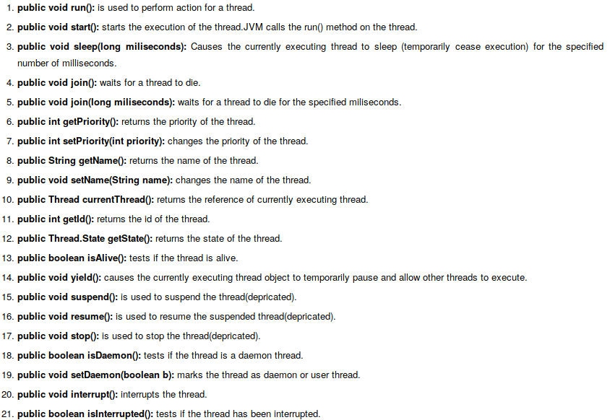

Slide 20
The Main Thread
When a Java program starts up, one thread begins running immediately.
This is usually called the main thread of your program, because it is the one that is executed when your program begins.
The main thread is important for two reasons:
  • It is the thread from which other “child” threads will be spawned.
  • Often, it must be the last thread to finish execution because it performs various shutdown actions.

Slide 21
Although the main thread is created automatically when your program is started, it can be controlled through a Thread object.
To do so, you must obtain a reference to it by calling the method currentThread( ), which is a public static member of Thread.
Its general form is shown here:
  static Thread currentThread( )
This method returns a reference to the thread in which it is called.
Once you have a reference to the main thread, you can control it just like any other thread.

Slide 22
class CurrentThreadDemo {
public static void main(String args[]) {
Thread t = Thread.currentThread();
System.out.println("Current thread: " + t);
t.setName("My Thread");
System.out.println("After name change: " + t);
try {
for(int n = 5; n > 0; n--) {
System.out.println(n);
t.sleep(1000);
}
} catch (InterruptedException e) {
System.out.println("Main thread interrupted");
} } }

Slide 23
Current thread: Thread[main,5,main]
After name change: Thread[My Thread,5,main]
5
4
3
2
1

Slide 24
By default, the name of the main thread is main. Its priority is 5, which is the default value, and main is also the name of the group of threads to which this thread belongs.
A thread group is a data structure that controls the state of a collection of threads as a whole.
After the name of the thread is changed, t is again output.
This time, the new name of the thread is displayed.

Slide 25
The sleep( ) method causes the thread from which it is called to suspend execution for the specified period of milliseconds.
  static void sleep(long milliseconds) throws InterruptedException
The number of milliseconds to suspend is specified in milliseconds. This method may throw an InterruptedException.
The sleep( ) method has a second form, shown next, which allows you to specify the period in terms of milliseconds and nanoseconds:
  static void sleep(long milliseconds, int nanoseconds) throws InterruptedException
This second form is useful only in environments that allow timing periods as short as nanoseconds.

Slide 26
final void setName(String threadName)
final String getName( )
Here, threadName specifies the name of the thread.

Slide 27
Starting a thread:
start() method of Thread class is used to start a newly created thread. It performs following tasks:
A new thread starts(with new callstack).
The thread moves from New state to the Runnable state.
When the thread gets a chance to execute, its target run() method will run.

Slide 28
Extending Thread
To create a thread, create a new class that extends Thread, and then to create an instance of that class.
The extending class must override the run( ) method, which is the entry point for the new thread.
It must also call start( ) to begin execution of the new thread.

Slide 29
Java Thread Example by extending Thread class
class Multi extends Thread{
public void run(){
System.out.println("thread is running...");
}
public static void main(String args[]){
Multi t1=new Multi();
t1.start();
}
}
Output:thread is running...

Slide 30
class NewThread extends Thread {
NewThread() {
// Create a new, second thread
super("Demo Thread");
System.out.println("Child thread: " + this);
start(); // Start the thread
}
// This is the entry point for the second thread.
public void run() {

Slide 31
try {
for(int i = 5; i > 0; i--) {
System.out.println("Child Thread: " + i);
Thread.sleep(500);
}
}
catch (InterruptedException e) {
System.out.println("Child interrupted.");
}
System.out.println("Exiting child thread.");
}
}

Slide 32
class ExtendThread {
public static void main(String args[]) {
new NewThread(); // create a new thread
try {
for(int i = 5; i > 0; i--) {
System.out.println("Main Thread: " + i);
Thread.sleep(1000);
}
} catch (InterruptedException e) {
System.out.println("Main thread interrupted.");
}
System.out.println("Main thread exiting.");
}
}

Slide 33
OUTPUT:
Child thread: Thread[Demo Thread,5,main]
Child Thread: 5
Main Thread: 5
Child Thread: 4
Main Thread: 4
Child Thread: 3
Child Thread: 2
Main Thread: 3
Child Thread: 1
Exiting child thread.
Main Thread: 2
Main Thread: 1
Main thread exiting.

Slide 34
Next, start( ) is called, which starts the thread of execution beginning at the run( ) method. This causes the child thread’s for loop to begin.
After calling start( ), NewThread’s constructor returns to main( ). When the main thread resumes, it enters its for loop.
Both threads continue running, sharing the CPU in single-core systems, until their loops finish.

Slide 35
Implementing Runnable
Another way to create a thread is to create a class that implements the Runnable interface.
Runnable abstracts a unit of executable code.
You can construct a thread on any object that implements Runnable.
To implement Runnable, a class need only implement a single method called run( ), which is declared like this:
  public void run( )

Slide 36
Inside run( ), you will define the code that constitutes the new thread.
run( ) can call other methods, use other classes, and declare variables, just like the main thread can.
The only difference is that run( ) establishes the entry point for another, concurrent thread of execution within your program.
This thread will end when run( ) returns.

Slide 37
After you create a class that implements Runnable, you will instantiate an object of type Thread from within that class.
Thread defines several constructors.
The one that we will use is shown here:
  Thread(Runnable threadOb, String threadName)
In this constructor, threadOb is an instance of a class that implements the Runnable interface.
This defines where execution of the thread will begin. The name of the new thread is specified by threadName.

Slide 38
After the new thread is created, it will not start running until you call its start( ) method, which is declared within Thread.
In essence, start( ) executes a call to run( ).
The start( ) method is shown here:
  void start( )

Slide 39
Java Thread Example by implementing Runnable interface
class Multi3 implements Runnable{
public void run(){
System.out.println("thread is running...");
}
public static void main(String args[]){
Multi3 m1=new Multi3();
Thread t1 =new Thread(m1);
t1.start();
}
}
Output:thread is running...

Slide 40
If you are not extending the Thread class,your class object would not be treated as a thread object.
So you need to explicitely create Thread class object.
Pass the object of the class that implements Runnable so that your class run() method may execute.

Slide 41
class NewThread implements Runnable {
Thread t;
NewThread() {
// Create a new, second thread
t = new Thread(this, "Demo Thread");
System.out.println("Child thread: " + t);
t.start(); // Start the thread
}

Slide 42
// This is the entry point for the second thread.
public void run() {
try {
for(int i = 5; i > 0; i--) {
System.out.println("Child Thread: " + i);
Thread.sleep(500);
}
} catch (InterruptedException e) {
System.out.println("Child interrupted.");
}
System.out.println("Exiting child thread.");
}
}

Slide 43
class ThreadDemo {
public static void main(String args[ ] ) {
new NewThread(); // create a new thread
try {
for(int i = 5; i > 0; i--) {
System.out.println("Main Thread: " + i);
Thread.sleep(1000);
}
} catch (InterruptedException e) {
System.out.println("Main thread interrupted.");
}
System.out.println("Main thread exiting.");
}
}

Slide 44
Inside NewThread’s constructor, a new Thread object is created by the following statement:
t = new Thread(this, "Demo Thread");
Passing this as the first argument indicates that you want the new thread to call the run( ) method on this object.
Next, start( ) is called, which starts the thread of execution beginning at the run( ) method. This causes the child thread’s for loop to begin.
After calling start( ), NewThread’s constructor returns to main( ). When the main thread resumes, it enters its for loop.
Both threads continue running, sharing the CPU in single-core systems, until their loops finish. The output produced by this program is as follows.

Slide 45
Child thread: Thread[Demo Thread,5,main]
Main Thread: 5
Child Thread: 5
Child Thread: 4
Main Thread: 4
Child Thread: 3
Child Thread: 2
Main Thread: 3
Child Thread: 1
Exiting child thread.
Main Thread: 2
Main Thread: 1
Main thread exiting.

Slide 46
Creating Multiple Threads
class NewThread implements Runnable {
String name; // name of thread
Thread t;
NewThread(String threadname) {
name = threadname;
t = new Thread(this, name);
System.out.println("New thread: " + t);
t.start(); // Start the thread
}

Slide 47
// This is the entry point for thread.
public void run() {
try {
for(int i = 5; i > 0; i--) {
System.out.println(name + ": " + i);
Thread.sleep(1000);
}
} catch (InterruptedException e) {
System.out.println(name + "Interrupted");
}
System.out.println(name + " exiting.");
}
}

Slide 48
class MultiThreadDemo {
public static void main(String args[]) {
new NewThread("One"); // start threads
new NewThread("Two");
new NewThread("Three");
try {
// wait for other threads to end
Thread.sleep(10000);
} catch (InterruptedException e) {
System.out.println("Main thread Interrupted");
}
System.out.println("Main thread exiting.");
}
}

Slide 49
New thread: Thread[One,5,main]
New thread: Thread[Two,5,main]
New thread: Thread[Three,5,main]
One: 5
Two: 5
Three: 5
One: 4
Two: 4
Three: 4
One: 3
Three: 3
Two: 3
One: 2
Three: 2
Two: 2
One: 1
Three: 1
Two: 1
One exiting.
Two exiting.
Three exiting.
Main thread exiting.

Slide 50
Using isAlive( ) and join( )
Two ways exist to determine whether a thread has finished. First, you can call isAlive( ) on the thread.
This method is defined by Thread, and its general form is shown here:
  final boolean isAlive( )
The isAlive( ) method returns true if the thread upon which it is called is still running. It returns false otherwise.

Slide 51
While isAlive( ) is occasionally useful, the method that you will more commonly use to wait for a thread to finish is called join( ), shown here:
  final void join( ) throws InterruptedException
This method waits until the thread on which it is called terminates.
Its name comes from the concept of the calling thread waiting until the specified thread joins it.
Additional forms of join( ) allow you to specify a maximum amount of time that you want to wait for the specified thread to terminate.

Slide 52
// Using join() to wait for threads to finish.
class NewThread implements Runnable {
String name; // name of thread
Thread t;
NewThread(String threadname) {
name = threadname;
t = new Thread(this, name);
System.out.println("New thread: " + t);
t.start(); // Start the thread
}

Slide 53
// This is the entry point for thread.
public void run() {
try {
for(int i = 5; i > 0; i--) {
System.out.println(name + ": " + i);
Thread.sleep(1000);
}
} catch (InterruptedException e) {
System.out.println(name + " interrupted.");
}
System.out.println(name + " exiting.");
}
}

Slide 54
class DemoJoin {
public static void main(String args[]) {
NewThread ob1 = new NewThread("One");
NewThread ob2 = new NewThread("Two");
NewThread ob3 = new NewThread("Three");
System.out.println("Thread One is alive: "
+ ob1.t.isAlive());
System.out.println("Thread Two is alive: "
+ ob2.t.isAlive());
System.out.println("Thread Three is alive: "
+ ob3.t.isAlive());
// wait for threads to finish

Slide 55
// wait for threads to finish
try {
System.out.println("Waiting for threads to finish.");
ob1.t.join();
ob2.t.join();
ob3.t.join();
} catch (InterruptedException e) {
System.out.println("Main thread Interrupted");
}
System.out.println("Thread One is alive: " + ob1.t.isAlive());
System.out.println("Thread Two is alive: " + ob2.t.isAlive());
System.out.println("Thread Three is alive: " + ob3.t.isAlive());
System.out.println("Main thread exiting.");
}
}

Slide 56
New thread: Thread[One,5,main]
New thread: Thread[Two,5,main]
New thread: Thread[Three,5,main]
Thread One is alive: true
Thread Two is alive: true
Thread Three is alive: true
Waiting for threads to finish.
One: 5
Two: 5
Three: 5
One: 4
Two: 4

Slide 57
Three: 4
One: 3
Two: 3
Three: 3
One: 2
Two: 2
Three: 2
One: 1
Two: 1
Three: 1
Two exiting.
Three exiting.
One exiting.
Thread One is alive: false
Thread Two is alive: false
Thread Three is alive: false
Main thread exiting.

Slide 58
Thread Priorities
Thread priorities are used by the thread scheduler to decide when each thread should be allowed to run.
In theory, over a given period of time, higher-priority threads get more CPU time than lower-priority threads.
In practice, the amount of CPU time that a thread gets often depends on several factors besides its priority.

Slide 59
A higher-priority thread can also preempt a lower-priority one.
For instance, when a lower-priority thread is running and a higher-priority thread resumes , it will preempt the lower-priority thread.

Slide 60
To set a thread’s priority, use the setPriority( ) method, which is a member of Thread.
  final void setPriority(int level)
Here, level specifies the new priority setting for the calling thread.
The value of level must be within the range MIN_PRIORITY and MAX_PRIORITY. Currently, these values are 1 and 10, respectively.
To return a thread to default priority, specify NORM_PRIORITY, which is currently 5.
These priorities are defined as static final variables within Thread.

Slide 61
You can obtain the current priority setting by calling the getPriority( ) method of Thread, shown here:
final int getPriority( )

Slide 62
Synchronization
When two or more threads need access to a shared resource, they need some way to ensurethat the resource will be used by only one thread at a time. The process by which this is achieved is called synchronization.

Slide 63
monitor
Key to synchronization is the concept of the monitor. A monitor is an object that is used as a mutually exclusive lock. Only one thread can own a monitor at a given time.
When a thread acquires a lock, it is said to have entered the monitor. All other threads attempting to enter the locked monitor will be suspended until the first thread exits the monitor. These other threads are said to be waiting for the monitor.
A thread that owns a monitor can reenter the same monitor if it so desires.
You can synchronize your code in either of two ways. Both involve the use of the synchronized keyword

Slide 64
Using Synchronized Methods
Synchronization is easy in Java, because all objects have their own implicit monitor associated with them.
To enter an object’s monitor, just call a method that has been modified with the synchronized keyword.
While a thread is inside a synchronized method, all other threads that try to call it (or any other synchronized method) on the same instance have to wait.
To exit the monitor and relinquish control of the object to the next waiting thread, the owner of the monitor simply returns from the synchronized method.

Slide 65
// This program is not synchronized.
class Callme {
void call(String msg) {
System.out.print("[" + msg);
try {
Thread.sleep(1000);
} catch(InterruptedException e) {
System.out.println("Interrupted");
}
System.out.println("]");
}
}

Slide 66
class Caller implements Runnable {
String msg;
Callme target;
Thread t;
public Caller(Callme targ, String s) {
target = targ;
msg = s;
t = new Thread(this);
t.start();
}
public void run() {
target.call(msg);
}
}

Slide 67
class Synch {
public static void main(String args[]) {
Callme target = new Callme();
Caller ob1 = new Caller(target, "Hello");
Caller ob2 = new Caller(target, "Synchronized");
Caller ob3 = new Caller(target, "World");
// wait for threads to end
try {
ob1.t.join();
ob2.t.join();
ob3.t.join();
} catch(InterruptedException e) {
System.out.println("Interrupted");
}
}
}

Slide 68
OUTPUT:
[Hello[World[Synchronized]
]
]
by calling sleep( ), the call( ) method allows execution to switch to another thread.
This results in the mixed-up output of the three message strings. In this program, nothing exists to stop all three threads from calling the same method, on the same object, at the same time.
This is known as a race condition, because the three threads are racing each other to complete the method.

Slide 69
To fix the preceding program, you must serialize access to call( ). That is, you must
restrict its access to only one thread at a time. To do this, you simply need to precede call( )’s
definition with the keyword synchronized, as shown here:
class Callme {
synchronized void call(String msg) {
...

Slide 70
This prevents other threads from entering call( ) while another thread is using it. After
synchronized has been added to call( ), the output of the program is as follows:
[Hello]
[Synchronized]
[World]

Slide 71
Any time that you have a method, or group of methods, that manipulates the internal state of an object in a multithreaded situation, you should use the synchronized keyword to guard the state from race conditions.
Remember, once a thread enters any synchronized method on an instance, no other thread can enter any other synchronized method on the same instance. However, nonsynchronized methods on that instance will continue to be callable.

Slide 72
The synchronized Statement
Imagine that you want to synchronize access to objects of a class that was not designed for multithreaded access. That is, the class does not use synchronized methods.
Further, this class was not created by you, but by a third party, and you do not have access to the source code.
Thus, you can’t add synchronized to the appropriate methods within the class.

Slide 73
Solution is: You simply put calls to the methods defined by this class inside a synchronized block.
This is the general form of the synchronized statement:
synchronized(objRef) {
// statements to be synchronized
}
Here, objRef is a reference to the object being synchronized.
A synchronized block ensures that a call to a synchronized method that is a member of objRef’s class occurs only after the current thread has successfully entered objRef’s monitor.

Slide 74
// This program uses a synchronized block.
class Callme {
void call(String msg) {
System.out.print("[" + msg);
try {
Thread.sleep(1000);
} catch (InterruptedException e) {
System.out.println("Interrupted");
}
System.out.println("]");
}
}

Slide 75
class Caller implements Runnable {
String msg;
Callme target;
Thread t;
public Caller(Callme targ, String s) {
target = targ;
msg = s;
t = new Thread(this);
t.start();
}
// synchronize calls to call()
public void run() {
synchronized(target) { // synchronized block
target.call(msg);
} } }

Slide 76
class Synch1 {
public static void main(String args[]) {
Callme target = new Callme();
Caller ob1 = new Caller(target, "Hello");
Caller ob2 = new Caller(target, "Synchronized");
Caller ob3 = new Caller(target, "World");
// wait for threads to end
try {
ob1.t.join();
ob2.t.join();
ob3.t.join();
} catch(InterruptedException e) {
System.out.println("Interrupted");
} } }

Slide 77
Interthread Communication
Multithreading replaces event loop programming by dividing yourtasks into discrete, logical units.
Threads also provide a secondary benefit: they do away with polling.
Polling is usually implemented by a loop that is used to check some condition repeatedly.
Once the condition is true, appropriate action is taken. This wastes CPU time.

Slide 78
For example, consider the classic queuing problem, where one thread is producing some data and another is consuming it.
To make the problem more interesting, suppose that the producer has to wait until the consumer is finished before it generates more data.
In a polling system, the consumer would waste many CPU cycles while it waited for the producer to produce.
Once the producer was finished, it would start polling, wasting more CPU cycles waiting for the consumer to finish, and so on. Clearly, this situation is undesirable.

Slide 79
To avoid polling, Java includes an elegant interprocess communication mechanism via the wait( ), notify( ), and notifyAll( ) methods.
These methods are implemented as final methods in Object, so all classes have them.
All three methods can be called only from within a synchronized context.

Slide 80
• wait( ) tells the calling thread to give up the monitor and go to sleep until some other thread enters the same monitor and calls notify( ) or notifyAll( ).
• notify( ) wakes up a thread that called wait( ) on the same object.
• notifyAll( ) wakes up all the threads that called wait( ) on the same object. One of the threads will be granted access.
These methods are declared within Object, as shown here:
final void wait( ) throws InterruptedException
final void notify( )
final void notify All( )
Additional forms of wait( ) exist that allow you to specify a period of time to wait.

Slide 81
Although wait( ) normally waits until notify( ) or notifyAll( ) is called, there is a possibility that in very rare cases the waiting thread could be awakened due to a spurious wakeup.
In this case, a waiting thread resumes without notify( ) or notifyAll( ) having been called.
Because of this remote possibility, Oracle recommends that calls to wait( ) should take place within a loop that checks the condition on which the thread is waiting.

Slide 82
// An incorrect implementation of a producer and consumer.
class Q {
int n;
synchronized int get() {
System.out.println("Got: " + n);
return n;
}
synchronized void put(int n) {
this.n = n;
System.out.println("Put: " + n);
}
}

Slide 83
class Producer implements Runnable {
Q q;
Producer(Q q) {
this.q = q;
new Thread(this, "Producer").start();
}
public void run() {
int i = 0;
while(true) {
q.put(i++);
}
}
}

Slide 84
class Consumer implements Runnable {
Q q;
Consumer(Q q) {
this.q = q;
new Thread(this, "Consumer").start();
}
public void run() {
while(true) {
q.get();
}
}
}

Slide 85
class PC {
public static void main(String args[]) {
Q q = new Q();
new Producer(q);
new Consumer(q);
System.out.println("Press Control-C to stop.");
}
}

Slide 86
Put:1
Got:1
Got:1
Got:1
Got:1
Got:1
Put:2
Put:3
Put:4
Put:5
Put:6
Put:7
Got:7

Slide 87
// A correct implementation of a producer and consumer.
class Q {
int n;
boolean valueSet = false;
synchronized int get() {
while(!valueSet)
try {
wait();
} catch(InterruptedException e) {
System.out.println("InterruptedException caught");
}

Slide 88
System.out.println("Got: " + n);
valueSet = false;
notify();
return n;
}
synchronized void put(int n) {
while(valueSet)
try {
wait();
} catch(InterruptedException e) {
System.out.println("InterruptedException caught");
}

Slide 89
this.n = n;
valueSet = true;
System.out.println("Put: " + n);
notify();
}
}

Slide 90
class Producer implements Runnable {
Q q;
Producer(Q q) {
this.q = q;
new Thread(this, "Producer").start();
}
public void run() {
int i = 0;
while(true) {
q.put(i++);
}
}
}

Slide 91
class Consumer implements Runnable {
Q q;
Consumer(Q q) {
this.q = q;
new Thread(this, "Consumer").start();
}
public void run() {
while(true) {
q.get();
}
}
}

Slide 92
class PCFixed {
public static void main(String args[]) {
Q q = new Q();
new Producer(q);
new Consumer(q);
System.out.println("Press Control-C to stop.");
}
}

Slide 93
Put:1
Got:1
Put:2
Got:2
Put:3
Got:3
Put:4
Got:4
Put:5
Got:6

Slide 94
Deadlock
Deadlock occurs when two threads have a circular dependency on a pair of synchronized objects.
• In general, it occurs only rarely, when the two threads time-slice in just the right way.
• It may involve more than two threads and two synchronized objects. (That is, deadlock can occur through a more convoluted sequence of events than just described.)

Slide 95
class A {
synchronized void foo(B b) {
String name = Thread.currentThread().getName();
System.out.println(name + " entered A.foo");
try {
Thread.sleep(1000);
} catch(Exception e) {
System.out.println("A Interrupted");
}
System.out.println(name + " trying to call B.last()");
b.last();
}
synchronized void last() {
System.out.println("Inside A.last");
}
}

Slide 96
class B {
synchronized void bar(A a) {
String name = Thread.currentThread().getName();
System.out.println(name + " entered B.bar");
try {
Thread.sleep(1000);
} catch(Exception e) {
System.out.println("B Interrupted");
}
System.out.println(name + " trying to call A.last()");
a.last();
}
synchronized void last() {
System.out.println("Inside A.last");
}
}

Slide 97
class Deadlock implements Runnable {
A a = new A();
B b = new B();
Deadlock() {
Thread.currentThread().setName("MainThread");
Thread t = new Thread(this, "RacingThread");
t.start();
a.foo(b); // get lock on a in this thread.
System.out.println("Back in main thread");
}

Slide 98
public void run() {
b.bar(a); // get lock on b in other thread.
System.out.println("Back in other thread");
}
public static void main(String args[]) {
new Deadlock();
}
}

Slide 99
OUTPUT:
MainThread entered A.foo
RacingThread entered B.bar
MainThread trying to call B.last()
RacingThread trying to call A.last()

Slide 100
Obtaining A Thread’s State
You can obtain the current state of a thread by calling the getState( ) method defined by Thread. It is shown here:
Thread.State getState( )
It returns a value of type Thread.State that indicates the state of the thread at the time at which the call was made.
State is an enumeration defined by Thread.

Slide 101
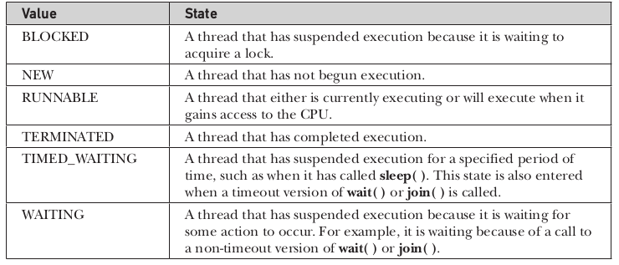

Slide 102
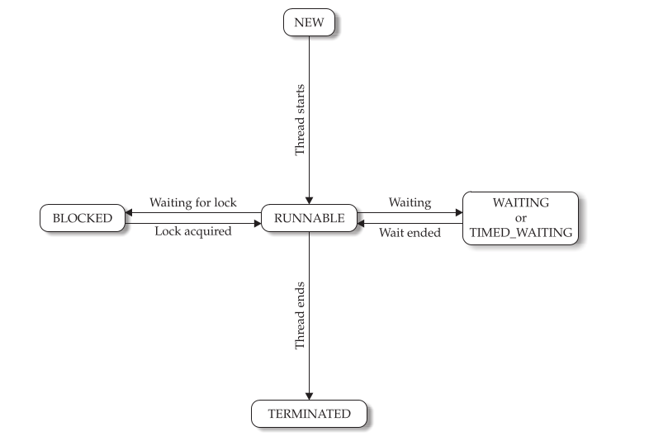

Slide 103
Given a Thread instance, you can use getState( ) to obtain the state of a thread.
For example, the following sequence determines if a thread called thrd is in the RUNNABLE state at the time getState( ) is called:
Thread.State ts = thrd.getState();
if(ts == Thread.State.RUNNABLE) // ...
It is important to understand that a thread’s state may change after the call to getState( ).
Thus, depending on the circumstances, the state obtained by calling getState( ) may not reflect the actual state of the thread only a moment later.

